Slide 1



Research on the usage of AI for road inspection and mobile mapping
Emil Vincent Ancker
Notes:
Hi everyone, it is very nice to be here and listening to such interesting presenters.
I will be introducing three interesting topics within road inspection and mobile mapping that we have worked with at Dynatest and sharing some of our experiences and the valuable knowledge we obtained.

Slide 2

Agenda
Introduction
Pavement crack detection using neural networks
Traffic sign detection using neural networks
Adressing one of the major problems of AI for adaption in an international setting
Notes:
I will start with a general introduction of myself and Dynatest.
Afterwards, I will go directly towards the first use case of neural networks for road inspection which is pavement crack detection.
Then I will introduce a use case of neural networks for mobile mapping which is traffic sign detection.
Finally, I will introduce the biggest problem we have discovered regarding an adaption of the machine learning methods in an international setting and how we have taken the first step towards solving it.

Slide 3
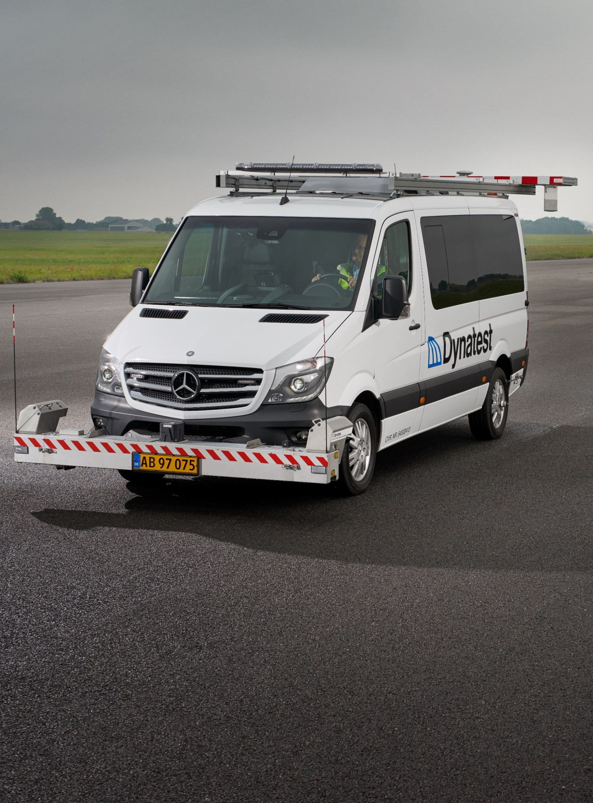

Who am I?
M.Sc. in Advanced Robotics Technology, University of Southern Denmark
Former employments at B&R Industrial Automation, University of Southern Denmark, and Universal Robots.
Three patents within artificial intelligence
Emil Vincent Ancker R&D Manager, Software & NPD
evr@dynatest.com
Notes:
So… Who am I?
My name is Emil Vincent Ancker and I am the R&D Manager for our Software and New Product Development teams. I have a master’s degree in advanced robotics from which is primarily centered around software, machine learning, computer vision, and statistics.
Then I have a background in the automation and robotics industry with previously employments at the University of Southern Denmark’s Unarmed Aerial Vehicle department and matemathical engineering department. Then I have also been at the innovation labs at Universal Robots and at B&R Industrial Automation..
So you might think, that’s fine.. But why is he here presenting about artificial intelligence? I have quite a lot of experience with practical implementations of AI which has resulted in three patents and a journal article under review.

Slide 4
Why am I presenting about AI methods for pavement inspection?
Dynatest A/S has a long history within road profiling
World-class systems for data acquisition and data analysis
Multi Functional Vehicle (MFV)
Dynatest Explorer
We feel the need to develop our road profiling business further!
The next step is…
Notes:
The next question you might think of could be… Why is Dynatest here presenting about AI methods for pavement inspection?
Dynatest A/S is a company with a long history within pavement analysis and especially road profiling. In this image I have shown one of our core products regarding road profiling, which is the multi-functional vehicle that is equipped with our own Road Surface Profiler and other really good sensor systems.
And then some of you may also know that we have a data analysis software named Dynatest Explorer that we use for analysing the data coming from these vehicles.
So, we have an established background in road profiling, but in the long run we see a need to develop new and smart solutions that for example might be more towards a lighter platform.

Slide 5
Pavement Crack Detection
Our experiments regarding the use of neural networks for pavement crack detection
Notes:
That was it for the introduction now I think that we are ready to dive into the interesting use cases of AI.
The first use case is pavement crack detection.

Slide 6
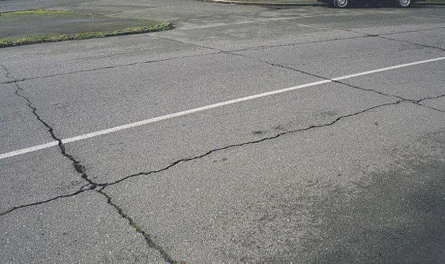
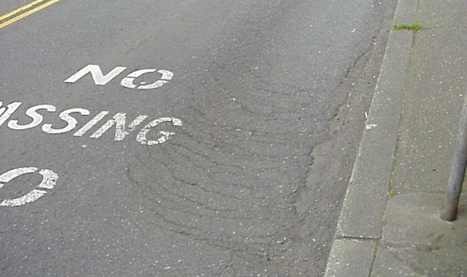
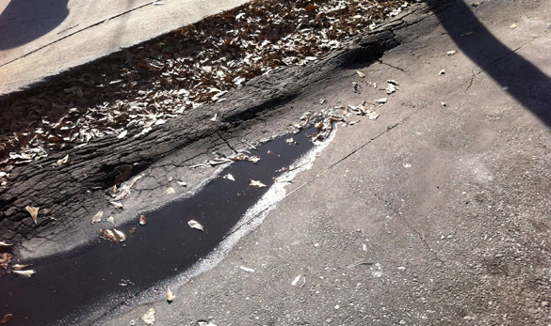
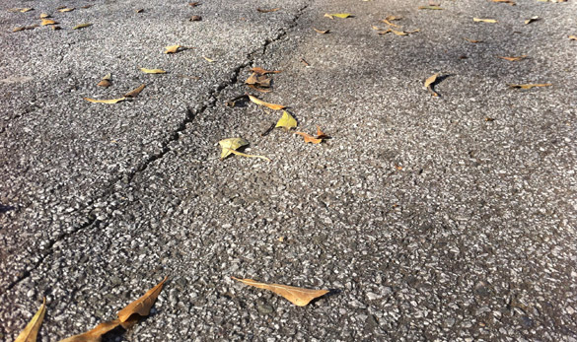
Sounds easy… Why is it hard?
Complex backgrounds & inhomogeneity of cracks
Outdoor computer vision
Light conditions
Weather conditions
Foreign objects
Disturbances
Imbalanced data
Why AI?
Notes:
So you might think that pavement crack detection, that’s easy.. Why even consider using AI methods?
Well first of all for all the uses cases I will present, we have restricted the usage of sensors to simple full HD cameras. No 3D sensors, no pattern projectors… Only 1 single camera.
So the problem of pavement crack detection is that we have a lot of complex background as you see in the examples I have here there is a lot of visual variance in the pavements. Furthermore, the cracks themselves visually can look very dissimilar.
Then we also have the problem of being situated in an outdoor computer vision setting, where the light conditions can have a big impact, the weather conditions can, the presence of foreign objects can make it hard and then things such as lens disturbances.
Finally, we also have a problem of the data being highly imbalanced, it can be very hard to have the same degree of different cracks and positive / negative samples.
So why consider AI methods? A lot of the variance we see coming from the outdoor computer vision situation are things we can incorporate into the training phase of the neural networks through a technique called data augmentation. The idea of data augmentation is that we can alter the training samples we have to simulate varying light conditions, disturbances, and similar. Furthermore, AI-based methods have shown to provide really good results within the field of computer vision and is really gaining traction within pavement inspection.

Slide 7
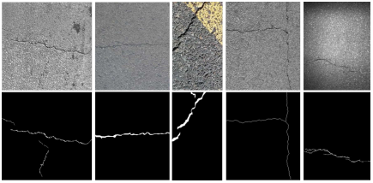
The Fundamentals
Labelled dataset
Collect it yourself
Public datasets
German Asphalt Pavement Distress Dataset (GAPs)
CRACK500
CrackTree
RDD2020
Segmentation vs Detection
FPHBN
Feature pyramid
Hierarchical boosting network
Notes:
Okay, so now you know why it is a hard problem and why it might be relevant to use AI-based methods. I will now introduce you to the fundamentals of our approach.
So as you might expect, we started out with considering should we collect a dataset ourselves or should we use a publicly available one? We went ahead with the public datasets.

Slide 8
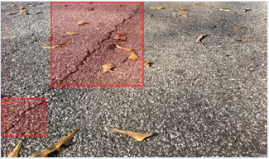
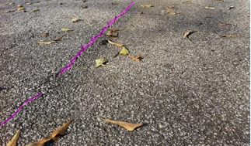
The Fundamentals
Labelled dataset
Collect it yourself
Public datasets
German Asphalt Pavement Distress Dataset (GAPs)
CRACK500
CrackTree
RDD2020
Segmentation vs Detection
FPHBN
Feature pyramid
Hierarchical boosting network
Figure: object detection
Figure: object segmentation
Notes:
Next, we had to decide on our approach, do we want to perform object detection where the result is a bounding-box on the cracks or object segmentation, where we classify the image down to a pixel-level accuracy and potentially also subpixel accuracy. We went ahead with the object segmentation approach since it allows for use to compute several interesting metrics for the cracks and because of the feature extraction process in the state-of-the-art networks which I will introduce now.

Slide 9
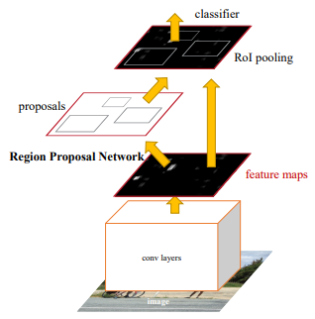
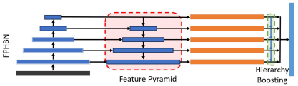
The Fundamentals
Labelled dataset
Collect it yourself
Public datasets
German Asphalt Pavement Distress Dataset (GAPs)
CRACK500
CrackTree
RDD2020
Segmentation vs Detection
FPHBN
Feature pyramid
Hierarchical boosting network
Why use this structure for crack detection?
Figure: structure of the Faster R-CNN neural network [1]
Figure: structure of the FPHBN neural network [2]
[1] Ren, S., He, K., Girshick, R., & Sun, J. (2015). Faster r-cnn: Towards real-time object detection with region proposal networks. Advances in neural information processing systems, 28.
[2] Yang, F., Zhang, L., Yu, S., Prokhorov, D., Mei, X., & Ling, H. (2019). Feature pyramid and hierarchical boosting network for pavement crack detection. IEEE Transactions on Intelligent Transportation Systems, 21(4), 1525-1535.
Notes:
So on the right side I have shown a general sketch of two different models, the Faster R-CNN network which is broadly used within object detection and the Feature Pyramid Hiearchical Boosting Network which has shown promising performance for pavement crack detection.
So, why didn’t we use the Faster R-CNN? The problem of many object detection networks is that they are highly based on high-level features because of the convolutional layers and approach of applying max-pooling. We choose a network with a feature pyramid network attached to a convolutional base and a hierarchical boosting method. The idea is that we can extract both high-level and low-level visual features and combine the based on how important they show to be during the training phase regarding the detection of pavement cracks.

Slide 10
An example
Pavement crack detection
Notes:
I will now show a few examples after we have trained the model on a few hundred images.

Slide 11
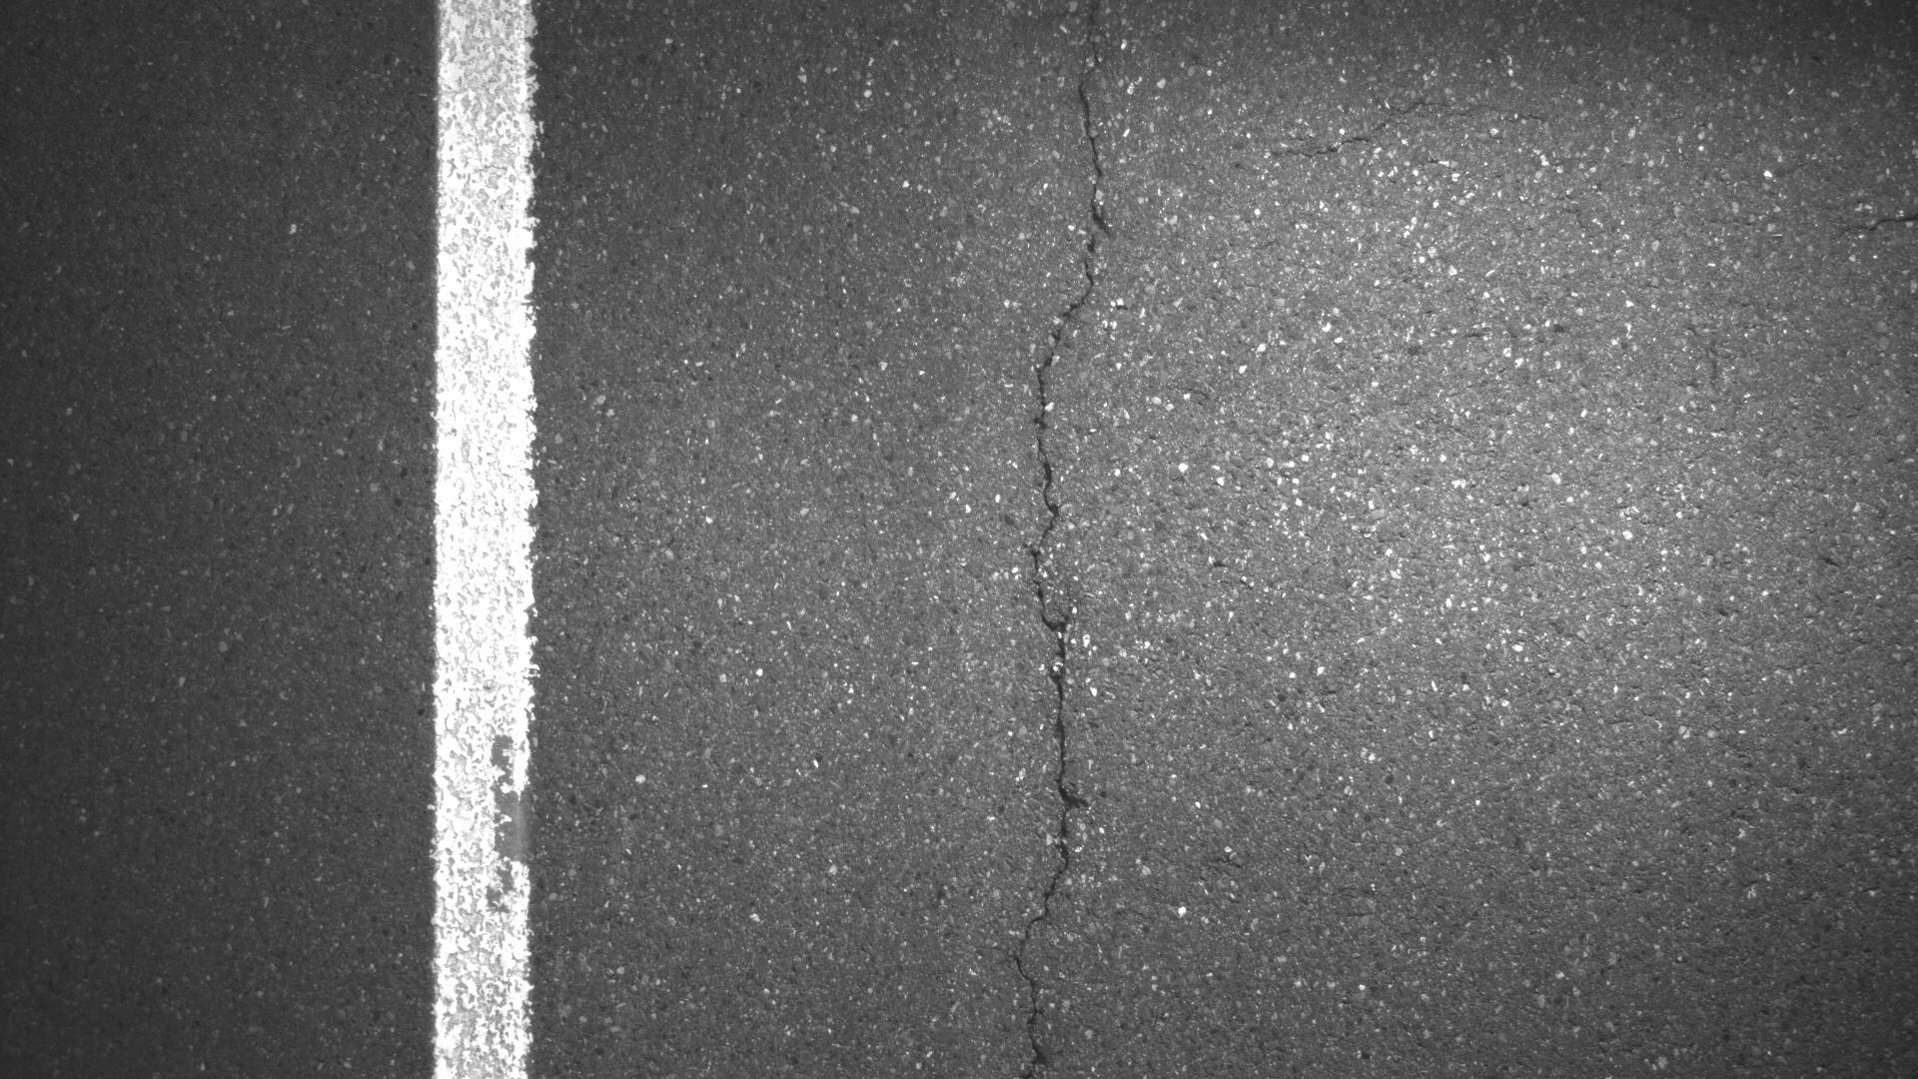
Notes:
So in this first example that we provide the model, you can clearly see a crack in the middle, and then there are some erosion of the lane marking which could confuse many models.

Slide 12
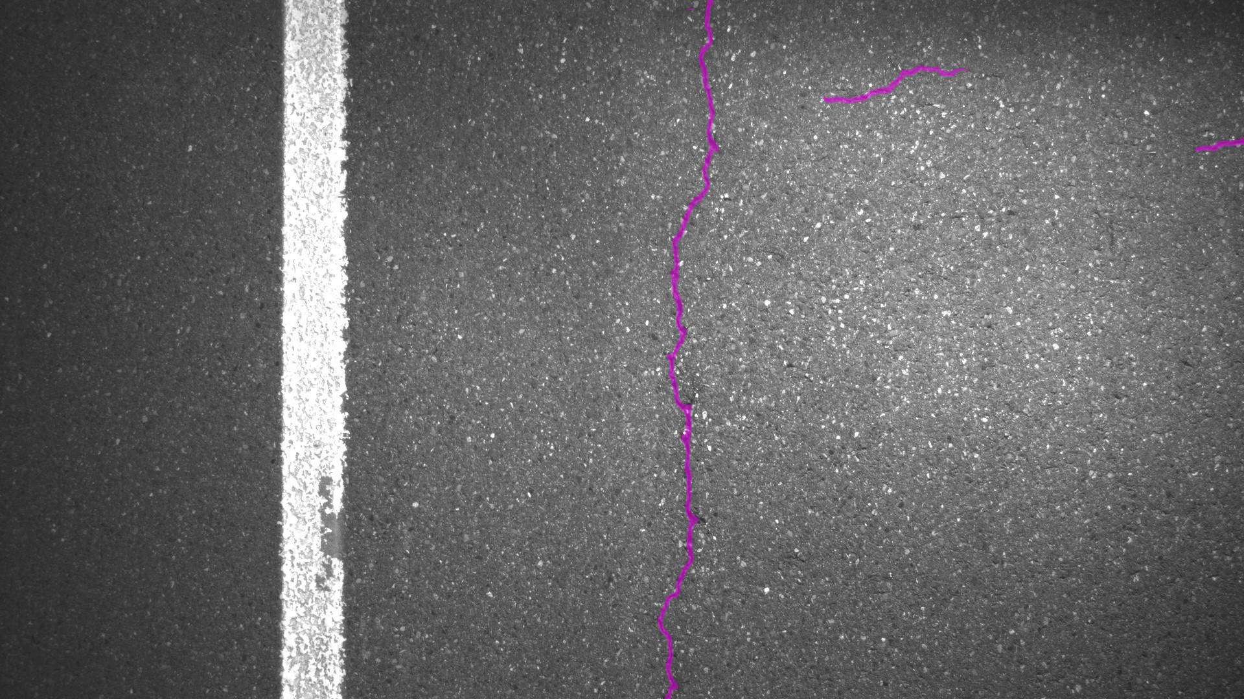
Notes:
And this is our result obtained from applying the network. What we then can do with these results is to compute varying metrics.

Slide 13
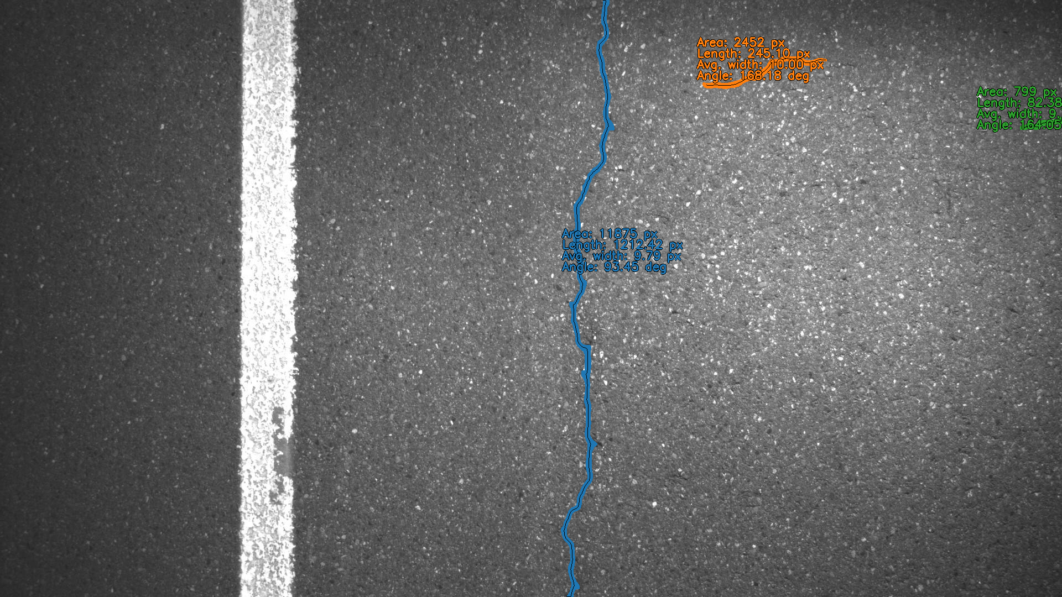
Notes:
So for example we can get it to compute the area of the crack, then we also deploy graph search techniques for estimating the total length of the crack and other interesting metrics.

Slide 14
Another example…
Pavement crack detection
Notes:
I will now show another example

Slide 15
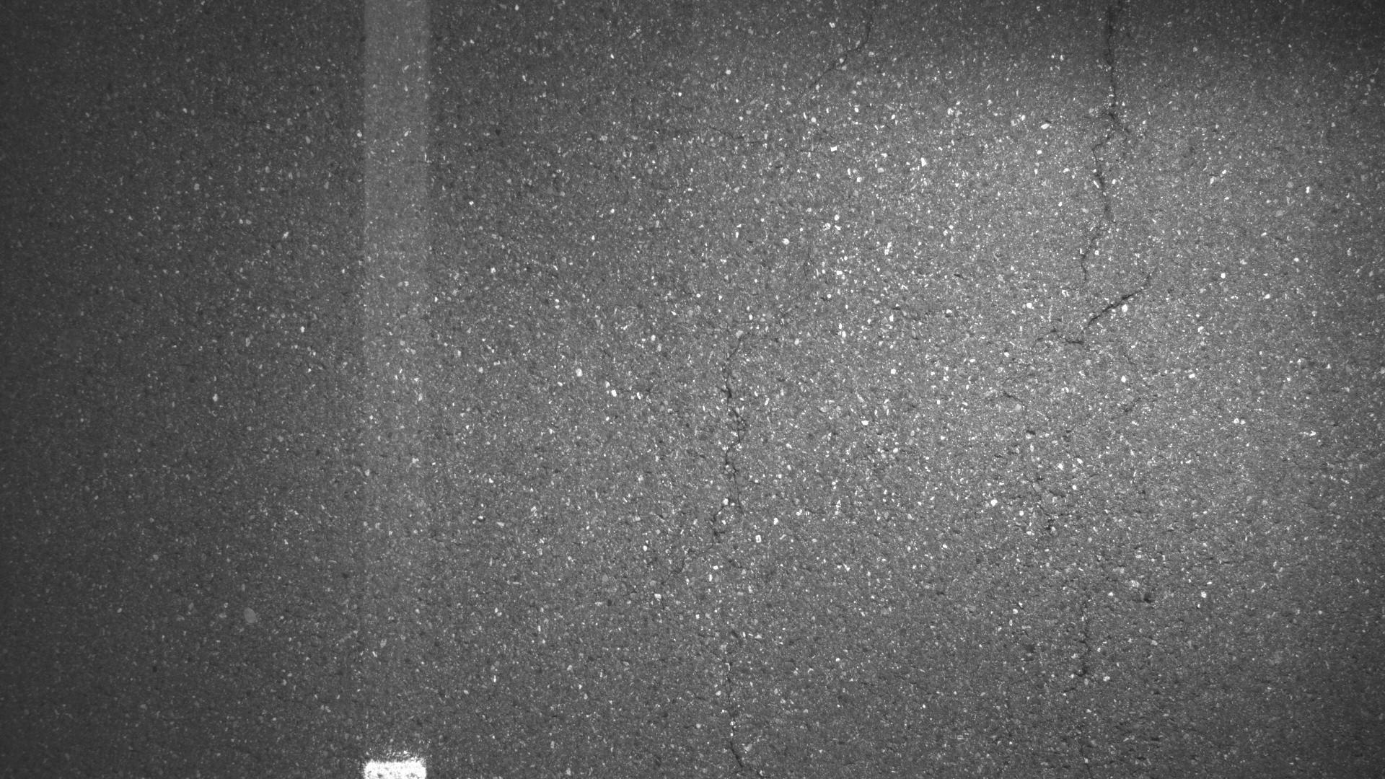
Notes:
In this example it might be a bit harder to see the cracks and they are definitely harder than the previous

Slide 16
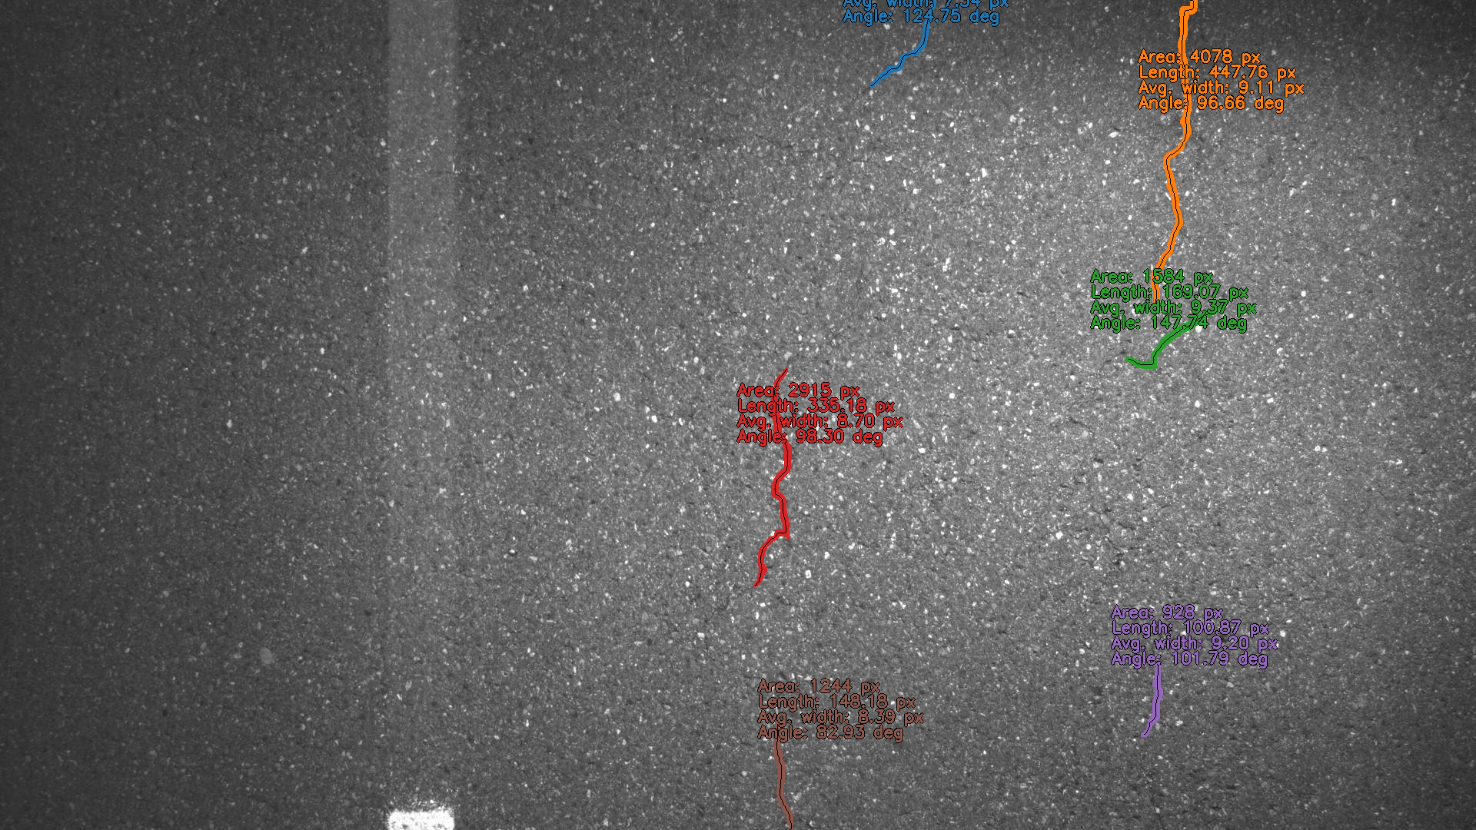
Notes:
But the segmentation network is still able to detect them. Unfortunately, I did not have the time prior to this presentation to run full-blown evaluations of the performance because we are still in the hyperparameter optimization process. However, if any of you are interested in the discussing the techniques of hyperparameter optimization for pavement crack detection please stop by me afterwards.

Slide 17
Traffic Sign Detection
Our experiments regarding the use of neural networks for traffic sign detection
Notes:
Okay, so that was it for our crack detection examples, now I will introduce our use case of neural networks for traffic sign detection.

Slide 18
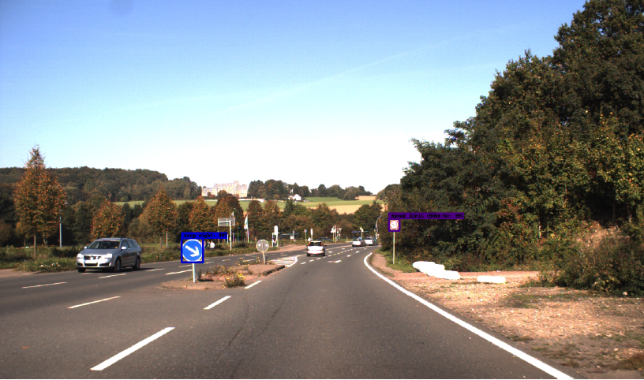
The Fundamentals
Objective
Detection (localization & classification)
Approach
Faster R-CNN with ResNet50 and FPN backbone
Went towards using Faster R-CNN as binary detector and a ResNet multi-class classifier
Evaluation
Notes:
The objective of traffic sign detection is to both localize the traffic signs within the images and classify which type of image it is.

Slide 19
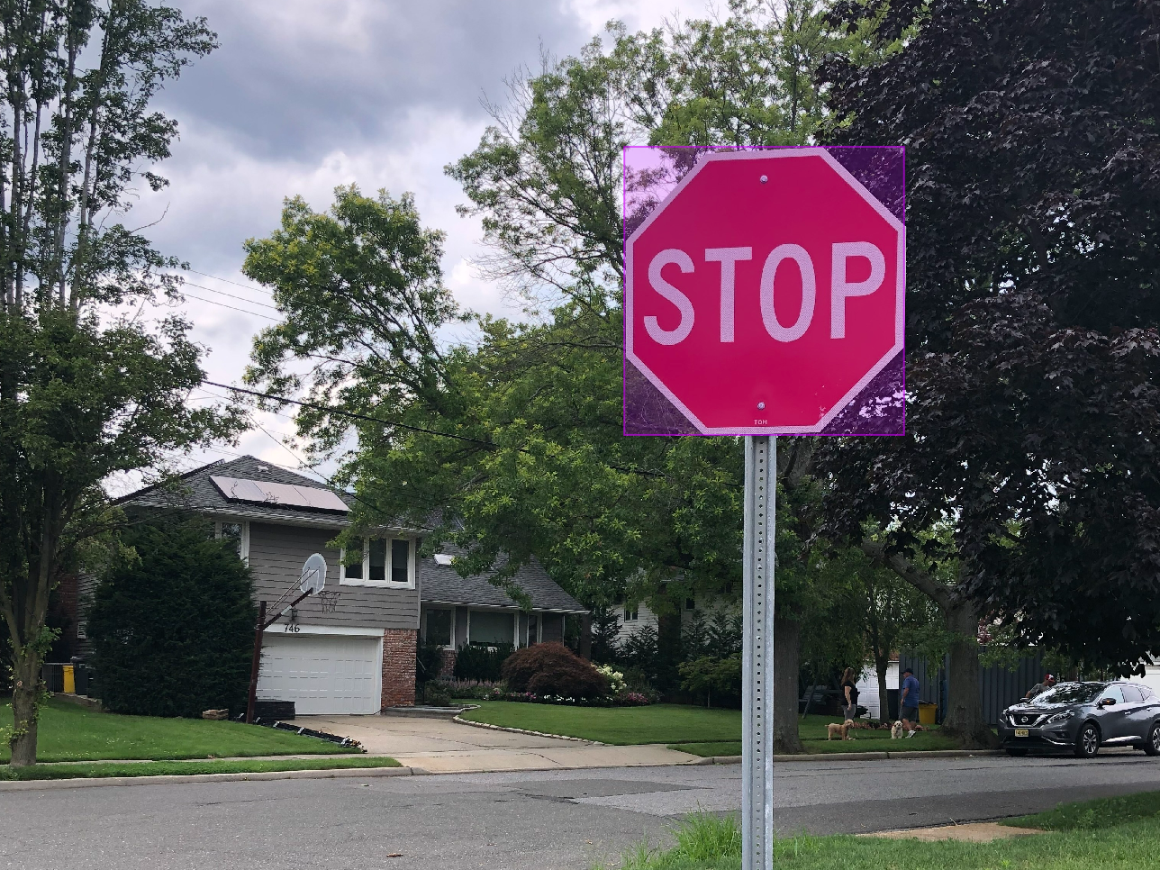
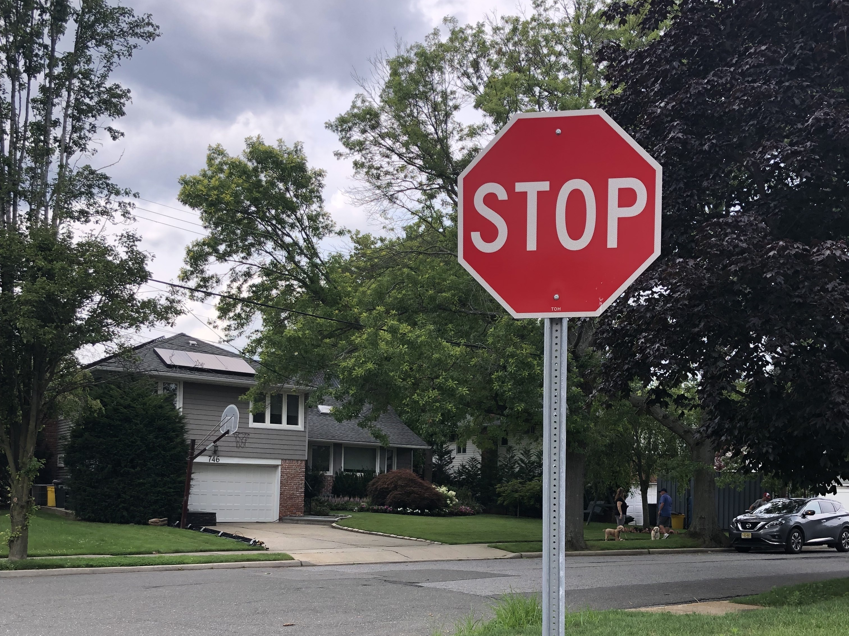
The Fundamentals
Objective
Detection (localization & classification)
Approach
Faster R-CNN with ResNet50 and FPN backbone
Went towards using Faster R-CNN as binary detector and a ResNet multi-class classifier
Evaluation
Faster R-CNN
ResNet
stop-sign: 0.91
Notes:
Regarding our approach to the problem, we decided to use an object detection network since we are not necessarily interested in a subpixel accuracy but more or less just want to know how many signs are there, what types of signs are they, where are they located?
We initially started with a Faster R-CNN using a ResNet50 architecture combined with a feature pyramid for feature extraction. However, we quickly saw some problems with this approach. Even tough a neural network potentially should be able to modulate any function and recent literature shows that with unlimited data and network size it is best to have one inifinitely large network. However, in the real world this is not possible. We quickly discovered that using a single network required a huge network to achieve good performance. Therefore, we split the functionality into two networks. A Faster R-CNN for binary object detection, which basically just states where are the signs – but says nothing about what type of sign it is, and a multi-class detection network based on the ResNet architecture for classifying which type of sign the detected signs are.

Slide 20
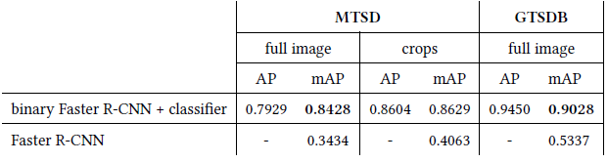
The Fundamentals
Objective
Detection (localization & classification)
Approach
Faster R-CNN with ResNet50 and FPN backbone
Went towards using Faster R-CNN as binary detector and a ResNet multi-class classifier
Evaluation
[3]
[4]
[3] Ertler, C., Mislej, J., Ollmann, T., Porzi, L., Neuhold, G., & Kuang, Y. (2020, August). The mapillary traffic sign dataset for detection and classification on a global scale. In European Conference on Computer Vision (pp. 68-84). Springer, Cham.
[4] Houben, S., Stallkamp, J., Salmen, J., Schlipsing, M., & Igel, C. (2013, August). Detection of traffic signs in real-world images: The German Traffic Sign Detection Benchmark. In The 2013 international joint conference on neural networks (IJCNN) (pp. 1-8). Ieee.
Notes:
Just to give you an idea of the performance increase by splitting the functionality into two networks having approximately the same total network size, we see a tremendous increase in the average precision performance.

Slide 21
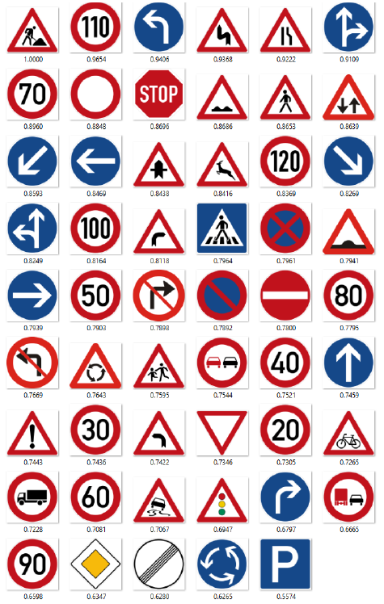
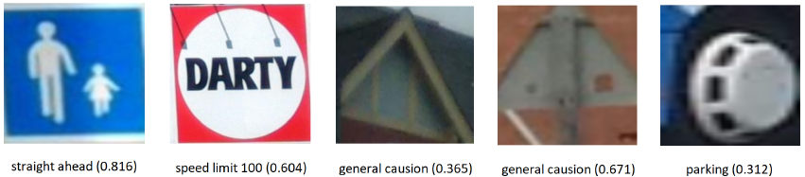
The Fundamentals
Objective
Detection (localization & classification)
Approach
Faster R-CNN with ResNet50 and FPN backbone
Went towards using Faster R-CNN as binary detector and a ResNet multi-class classifier
Evaluation
Figure: examples where the model fails
Notes:
So.. which errors is it that our model makes and how severe are they?
Well currently, there are several signs that we can detect really well such as road work signs and some speed limit signs. However, if you look at the examples of how the model performs, then I definitely would not let the neural network drive my car because of the beware of children sign is classified as a “proceed straight ahead sign”.
So overall, we have some good results, however, the network still makes some errors.

Slide 22
Making AI globally useful
Our experiments regarding the usage of synthetic data for AI methods
Notes:
Okay, so that’s fine we have good performance on a single dataset. How do we make it usable in a global setting?

Slide 23

The Problem
Figure: two signs from different countries with same meaning
Notes:
The problem behind using such a network in a global setting can be illustrated through this example.
These two traffic signs originate from two different countries. However, they have the exact same underlying meaning. That is a problem for the network.

Slide 24
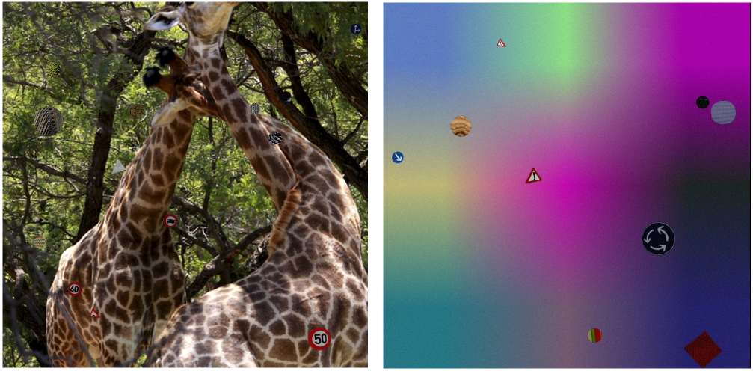
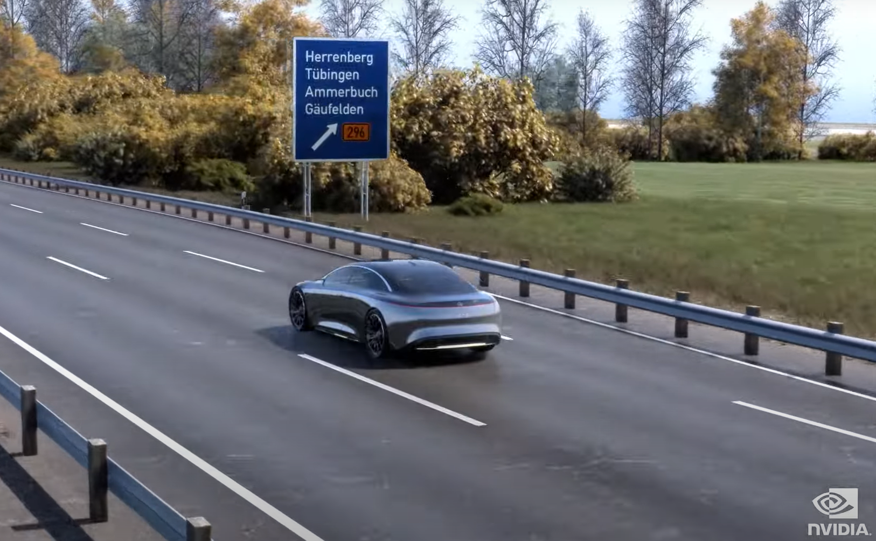
Generation of artificial data
Figure: examples of simple artificial data
Figure: image from NVIDIA omniverse
Notes:
So how can we solve this problem? We have had tremendous success with an approach based on generation of artificial data. It is an approach that initially might seem similar to data augmentation. However, we do not augment existing data, we generate entirely new data for the network dependent on its performance.
Generally, there are two approaches that we have exploited, the first is rendering traffic sign images and noise into random backgrounds, the other is to use simulation environments and render traffic signs into them.

Slide 25
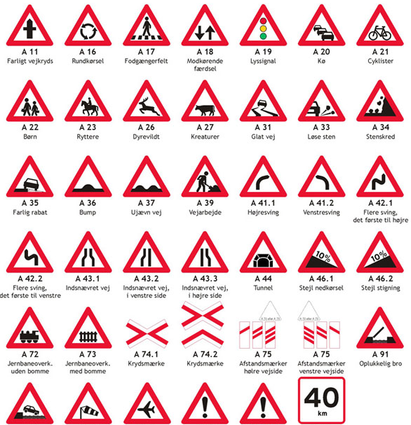
Generation of artificial data
Traffic sign examples
Training and data generation will continue until acceptable performance has been achieved
Artificial data generator
Virtual environment
Neural network training
Neural network weights
Notes:
So, what is the idea behind that training process?
The idea is that we receive a collection of traffic sign pictures based on which region the network should operate within, then we generate some artificial data using one of the two approaches or both. We train the neural network on the images, and evaluate it on some validation examples. Based on the performance of the model we then generate a new set of images and continue the training phase in this loop until we are satisfied with the performance.

Slide 26
Dynatest Explorer
New release: version 4.0.0
Notes:
And that was it for our use cases. I hope that you found it interesting. In the end I just want to make you aware that we will be launching a new version of Dynatest Explorer this week.

Slide 27
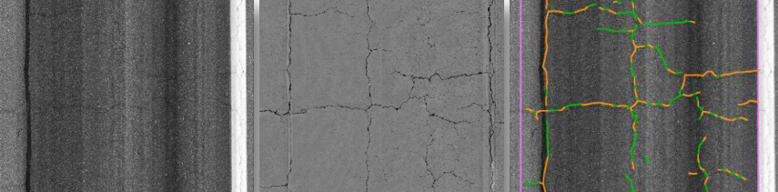
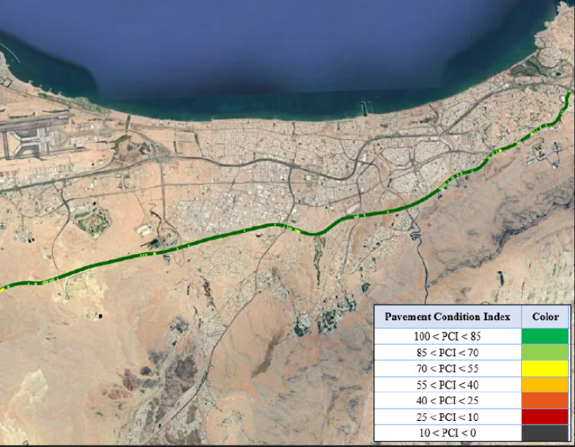
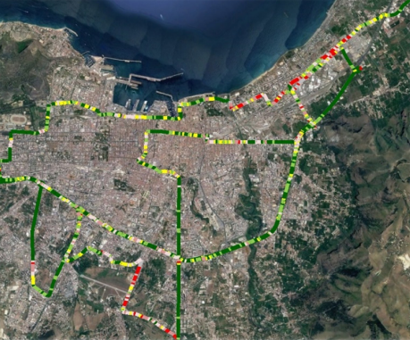
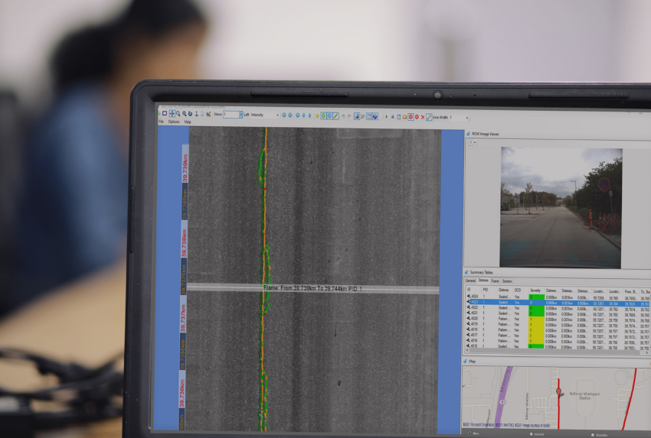
Dynatest Explorer
Version 4.0.0
New features in Dynatest Explorer
Boeing Bump Index (BBI) calculation module
Pavement Condition Index (PCI) calculation module for airports
Support for more LCMS Analyser SDKs and on-demand installation module
See the release notes on our website for a list of bug fixes and other improvements.
Notes:
The new version will include a module for calculating the Boeing Bump Index, Pavement Condition Index for airports and then we have made it possible to mor easily interact with the LCMS Analyser SDKs.
During this week we will also make the release notes public where you can see the full list of new features, improvements and bug fixes.

Slide 28

Pavement
expertise
in action
Notes:
Thank you for listening.

